Slide 1
The Role of Tone in Writing Customer Service Responses
Corporate Communication Research | PES University

Slide 2
Introduction
Shift from verbal to written customer service communication
Tone replaces non-verbal cues in digital interactions
Strong impact on customer satisfaction, trust, and service recovery

Slide 3
Objectives of the Study
Analyze role of tone in customer service responses
Identify factors influencing customer tone preference
Compare effectiveness of different tonal approaches

Slide 4
Research Methodology
Descriptive and empirical research design
Primary data collected via online survey
Sample size: 72 respondents
Tools: Percentage analysis, charts, mean scores

Slide 5
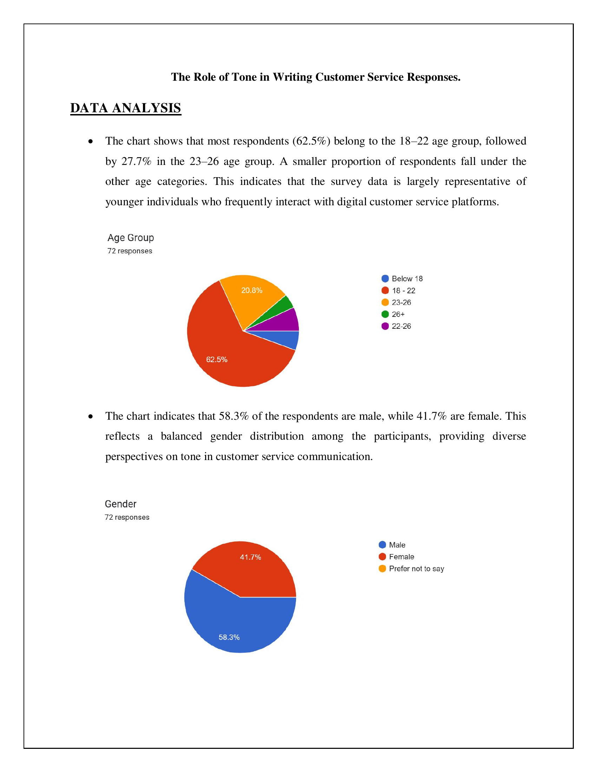
Demographic Analysis

Slide 6
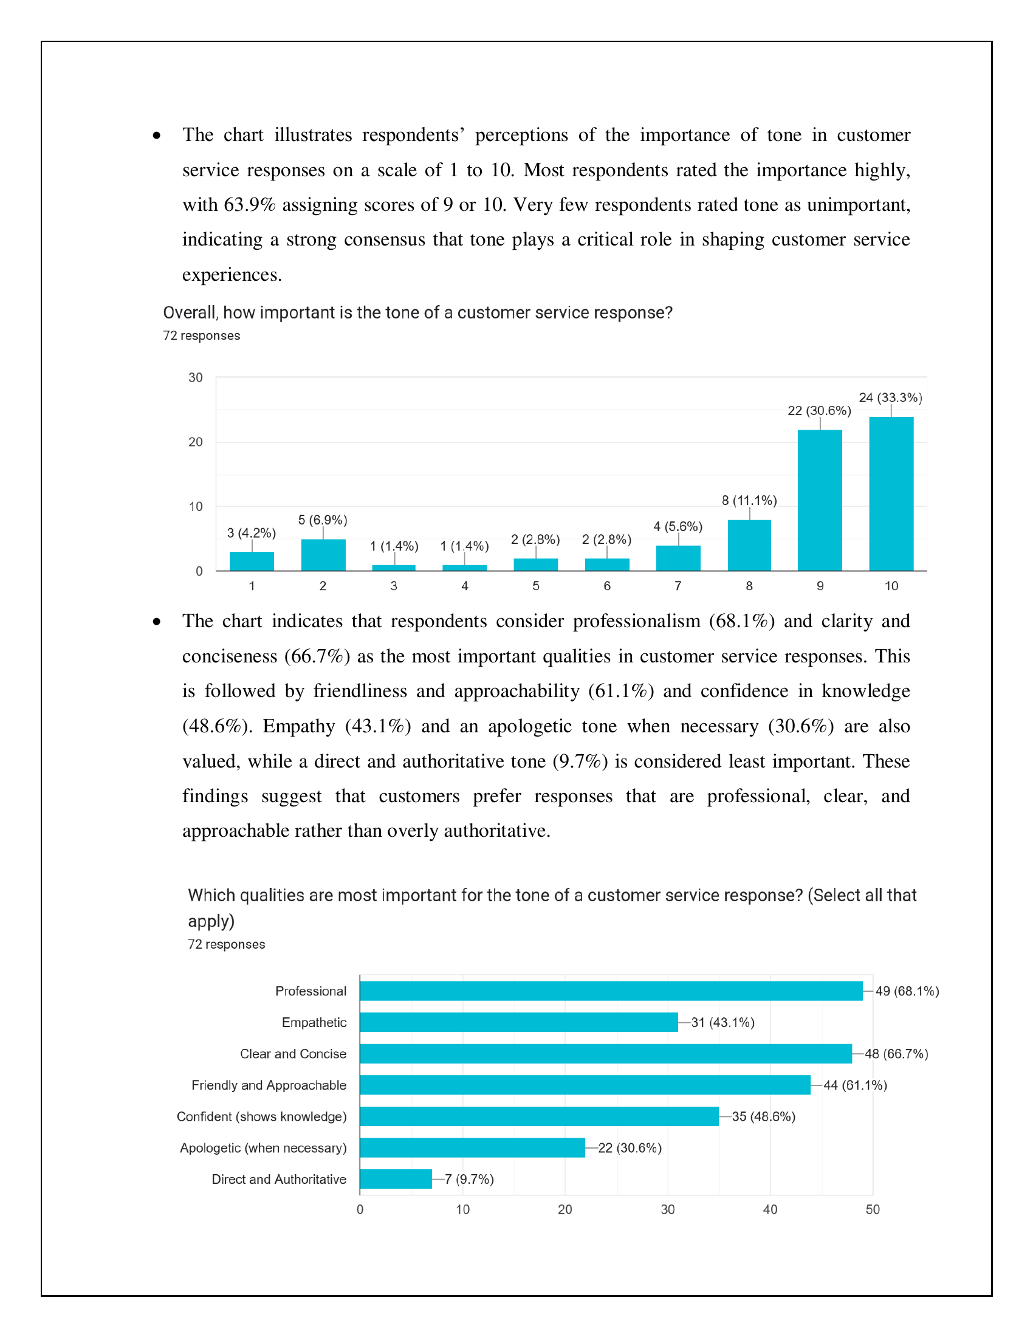
Importance of Tone & Preferred Qualities

Slide 7
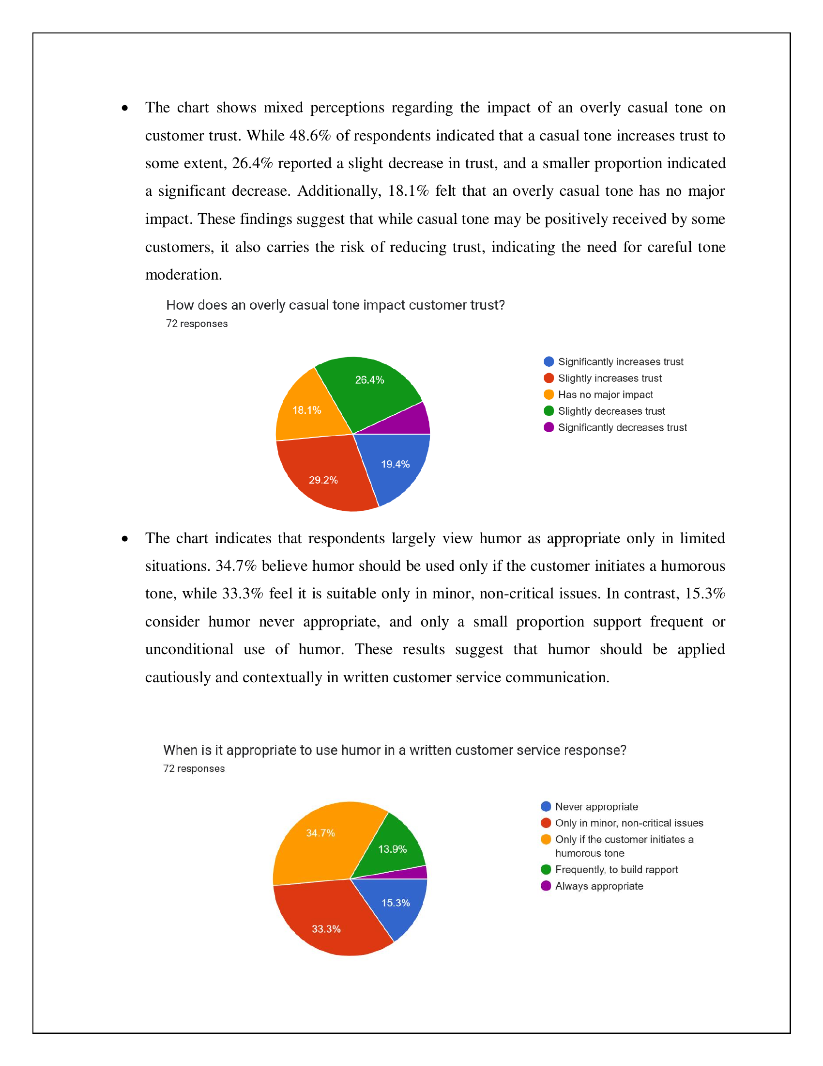
Casual Tone & Use of Humor

Slide 8
Key Findings
Tone is considered critical in customer service communication
Professional, clear, and friendly tones are most preferred
Overly casual or humorous tones can reduce trust

Slide 9
Conclusion
No single tone fits all situations
Tone effectiveness is context-dependent
Tone management is a strategic necessity for organizations

Slide 10
Recommendations
Develop tone-specific response guidelines
Train employees on emotional intelligence and tone management
Use humor cautiously and contextually

